Slide 1

2018 Spring Training

Slide 2
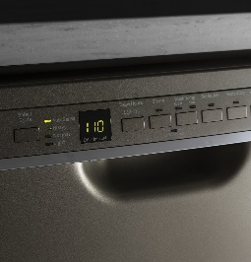
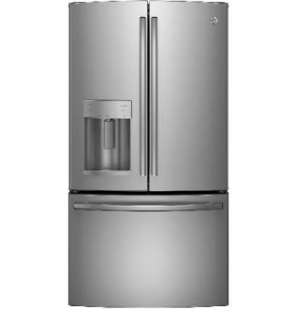
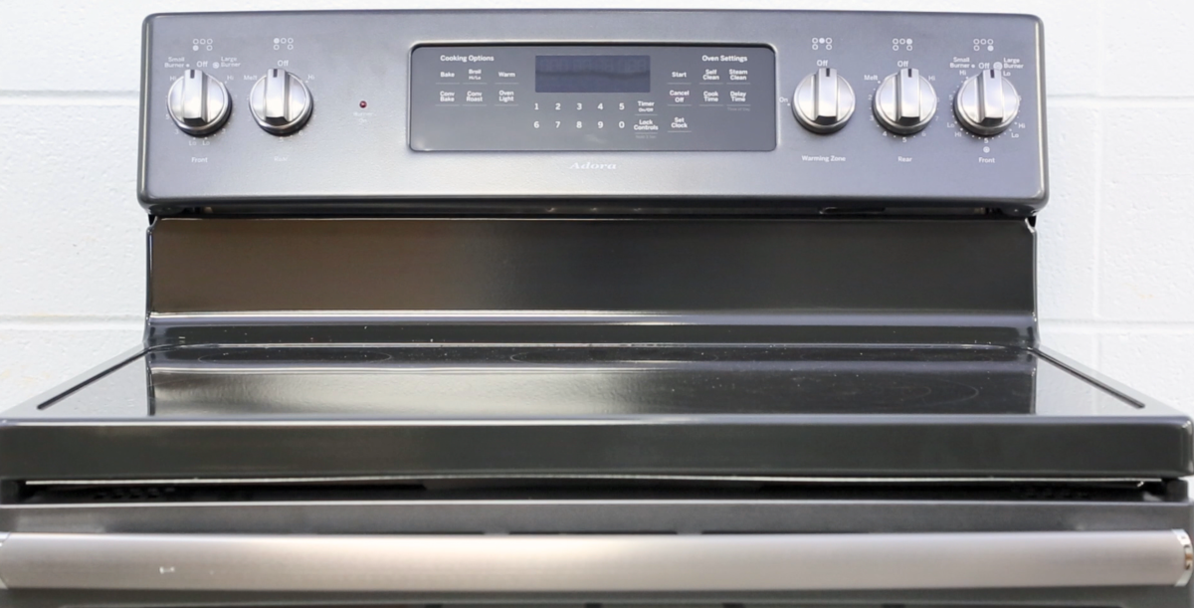
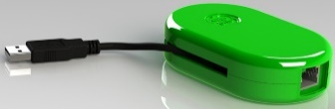
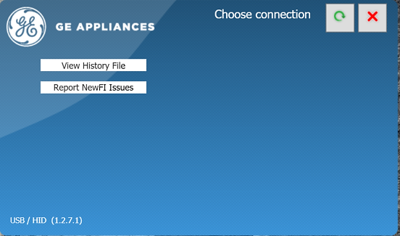
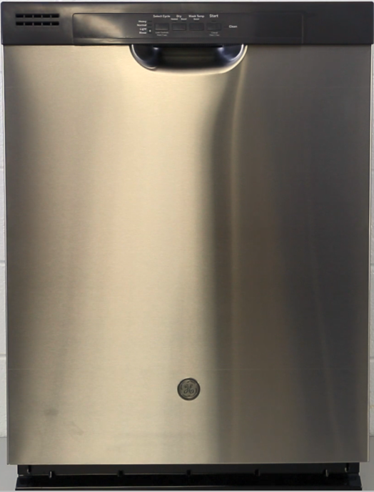
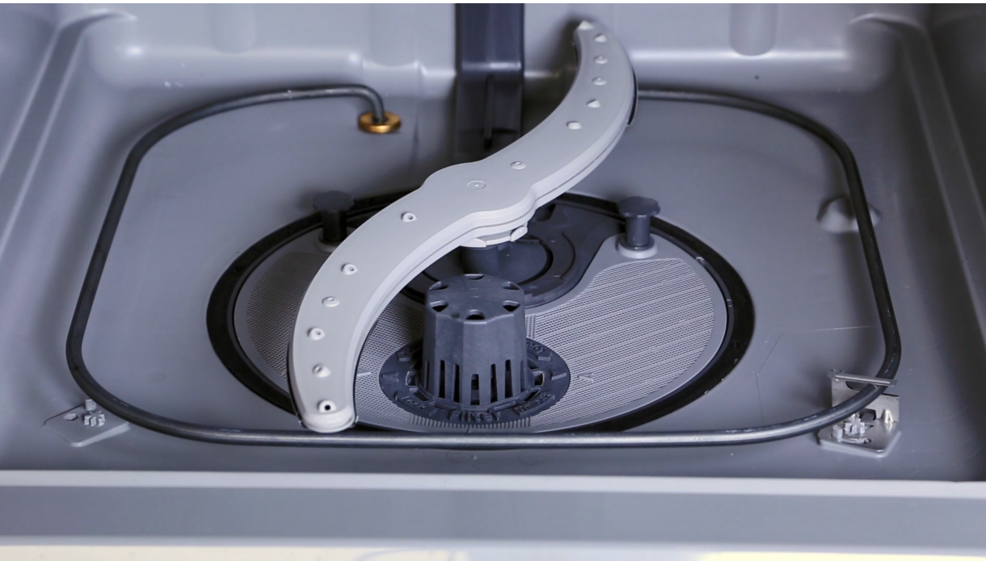
2018 Spring TRAINING
Nitrogen Usage and Procedures
Dishwasher
Range
Top Load Washer
NewFI

Slide 3
2018 Spring TRAINING
Nitrogen Usage and Procedures
Dishwasher
Range
Top Load Washer
NewFI

Slide 4
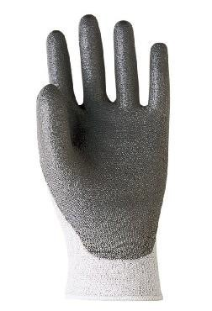
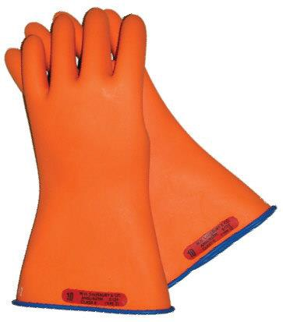
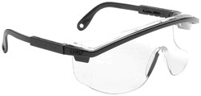






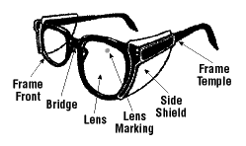
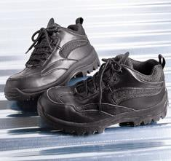
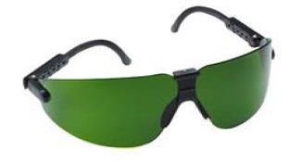









GE Factory Service Employees are required to use safety glasses with side shields, safety gloves & steel toe shoes for all repairs.
Electrically Rated Glove and Dyneema® Cut Resistant Glove Keeper
Plano Type Safety Glasses
Dyneema® Cut
Resistant Glove
Prescription Safety Glasses
Safety Glasses must be ANSI Z87.1-2003 compliant
Steel Toe Work Boot
Brazing Glasses

Slide 5
Prior to disassembly of the Refrigerator to access components, GE Factory Service technicians are REQUIRED to follow the Lockout / Tagout (LOTO) 6 Step Process
Step 1 Plan and Prepare | Step 4 Apply LOTO device & Lock
Step 2 Shut down the appliance | Step 5 Control (discharge) stored energy
Step 3 Isolate the appliance | Step 6 “Try It” Verify that the appliance is locked out

